Slide 1
Power Flow Calculation in Distribution Systems
EE 653 Power distribution system modeling, optimization and simulation
GRA: Qianzhi Zhang
Advisor: Dr. Zhaoyu Wang
Department of Electrical and Computer Engineering
Iowa State University

Slide 2
Outline
Conventional power flow calculations in transmission systems
Gauss-Seidel method
Newton-Raphson method
Features of electrical distribution networks
Ill-conditioned Jacobian matrix in Newton-Raphson method
Power flow calculations in distribution systems
Forward/Backward sweep method
Kirchhoff’s formulation
BIBC & BCBV matrices
Dist-flow formulation
Linearized Dist-flow formulation
Extension to three-phase systems
Modified Newton-Raphson method

Slide 3
Power flow calculation
Power flow analysis of power system is used to determine the steady state solution for a given set of bus loading condition.
$$P_{ij}=\sum_{j=1}^{j∈N_{i}}{\left|V_{i}\right|\left|V_{j}\right|\left(G_{ij}\cos\left(θ_{i}−θ_{j}\right)+B_{ij}\sin\left(θ_{i}−θ_{j}\right)\right)}$$
$$Q_{ij}=\sum_{j=1}^{j∈N_{i}}{\left|V_{i}\right|\left|V_{j}\right|\left(G_{ij}\sin\left(θ_{i}−θ_{j}\right)−B_{ij}\cos\left(θ_{i}−θ_{j}\right)\right)}$$
Parameters
Network topology $j∈N_{i}$
Line conductance and susceptance $G_{ij}$, $B_{ij}$
Variables
Bus voltage magnitudes and bus phase angles $V_{i}$, $θ_{i}$
Line active and reactive power flow $P_{ij}$, $Q_{ij}$

Slide 4
Power flow calculation
$$P_{ij}=\sum_{j=1}^{j∈N_{i}}{\left|V_{i}\right|\left|V_{j}\right|\left(G_{ij}\cos\left(θ_{i}−θ_{j}\right)+B_{ij}\sin\left(θ_{i}−θ_{j}\right)\right)}$$
$$Q_{ij}=\sum_{j=1}^{j∈N_{i}}{\left|V_{i}\right|\left|V_{j}\right|\left(G_{ij}\sin\left(θ_{i}−θ_{j}\right)−B_{ij}\cos\left(θ_{i}−θ_{j}\right)\right)}$$
Usually, two of the four variables are known for each bus:
PQ bus (load) at which $P$and $Q$ are fixed; iteration solves for V and $θ$ .
PV bus (generator) at which P and V are fixed; iteration solves for $θ$ and $Q$.
Slack bus at which the V and $θ$ are fixed; iteration solves for P and Q.

Slide 5
Conventional power flow calculation in transmission systems
Gauss-Seidel method
It needs to rewrite the equations in an implicit form: $x=h(x)$
It starts with initial guess: $x^{0}$
Then we update the solution using the following form: $x^{n+1}=h(x^{n})$
It repeats the procedure until converged
It needs to put the equation in the correct form:
$$S_{i}=V_{i}I_{i}^{∗}=V_{i}{\left(\sum_{j=1}^{n}{Y_{ij}V_{j}}\right)}^{∗}=V_{i}\sum_{j=1}^{n}{Y_{ij}^{∗}V_{j}^{∗}}$$
$$S_{i}^{∗}=V_{i}^{∗}I_{i}=V_{i}^{∗}\sum_{j=1}^{n}{Y_{ij}V_{j}}$$
$$\frac{S_{i}^{∗}}{V_{i}^{∗}}=\sum_{j=1}^{n}{Y_{ij}^{∗}V_{j}^{∗}}=Y_{ii}V_{i}+\sum_{j=1, j≠i}^{n}{Y_{ij}V_{j}}$$
The update rule for each bus voltage:
$$V_{i}^{n+1}=\frac{1}{Y_{ii}}\left(\frac{S_{i}^{∗}}{{V_{i}^{n}}^{∗}}−\sum_{j=1, j≠i}^{n}{Y_{ij}V_{j}^{n}}\right)=h_{i}\left(V_{1}^{n},V_{2}^{n},…,V_{I}^{n}\right)$$

Slide 6
Conventional power flow calculation in transmission systems
Newton-Raphson method
$x$ is the vector of $θ$and $V$for all the buses, except for the slack bus.
Active and reactive power balance equation: $f(x)$
$$x^{n+1}=x^{n}−J^{−1}(x^{n})f\left(x^{n}\right)$$
where
J$\left(x\right)=\left[\begin{matrix}\frac{∂P}{∂θ} & \frac{∂P}{∂V} \\ \frac{∂Q}{∂θ} & \frac{∂Q}{∂V}\end{matrix}\right]$
$$x=\left[\begin{matrix}θ \\ V\end{matrix}\right]$$
$$f\left(x\right)=\left[\begin{matrix}P\left(x\right) \\ Q\left(x\right)\end{matrix}\right]$$
Compared to Gauss-Seidel method, Newton-Raphson method has a faster convergence rate, but each iteration takes much longer time. Also, Newton-Raphson is more complicated to code.

Slide 7
How to accelerate?
Accelerated (convergence) Gauss-Seidel method
Previously, it calculates each value $x$ as:${ x}^{n+1}=h(x^{n})$
To accelerate convergence, the above equation can be rewritten as:${ x}^{n+1}=x^{n}+h\left(x^{n}\right)−x^{n}$
Acceleration parameter $α$:${ x}^{n+1}=x^{n}+α(h\left(x^{n}\right)−x^{n})$
Larger value of $α$ may result in faster convergence
Decoupled Newton-Raphson method
Approximation of the Jacobian matrix is used to decouple the real and reaction power equations.
J$\left(x\right)=\left[\begin{matrix}\frac{∂P}{∂θ} & 0 \\ 0 & \frac{∂Q}{∂V}\end{matrix}\right]$
Assume $\left(θ_{i}−θ_{j}\right)≈0$, thus $\sin\left(θ_{i}−θ_{j}\right)≈0$
$$\frac{∂P_{i}}{∂V_{j}}=\left|V_{i}\right|B_{ij}\sin\left(θ_{i}−θ_{j}\right)≈0$$
$$θ^{n+1}=θ^{n}−{\left[\frac{∂P}{∂θ}\right]}^{−1}P\left(x^{n}\right)$$
$$\frac{∂Q_{i}}{∂θ_{j}}=−\left|V_{i}\right|\left|V_{j}\right|B_{ij}\sin\left(θ_{i}−θ_{j}\right)≈0$$
$$V^{n+1}=V^{n}−{\left[\frac{∂Q}{∂V}\right]}^{−1}Q\left(x^{n}\right)$$

Slide 8
Disadvantages of Gauss-Seidel and Newton-Raphson
Traditional Gauss-Seidel method and Newton-Raphson method need the calculation of the Y matrix and Jacobian matrix.
When solving large power systems, the most difficult computation task is inverting the Y matrix and Jacobian matrix:
Inverting a full matrix needs an order of $n^{3}$ operation, meaning the amount of computation increases with the cube of the size $n$.
This amount of computation can be decreased substantially by recognizing both Y matrix and Jacobian matrix are sparse matrices.
Using sparse matrix methods results in a computational order of about $n^{1.5}$.

Slide 9
Features of electrical distribution networks
Because of the following special features in distribution network, the Y matrix and Jacobian matrix ceases to be diagonally dominant and convergence problems arise in power flow solutions that rely on its inverse [1].
Radial or near radial structure
High R/X rations
Un-transposed lines
Multi-phase, unbalanced, grounded or ungrounded operation
Multi-phase, multi-mode control distribution equipment
Unbalanced distributed load
Extremely large number of branches/nodes
Thus, traditional Gauss-Seidel method and Newton-Raphson method have lost popularity due to their poor convergence in distribution system studies.
[1] C. S. Cheng and D. Shirmohammadi, "A three-phase power flow method for real-time distribution system analysis," in IEEE Transactions on Power Systems, vol. 10, no. 2, pp. 671-679, May 1995.

Slide 10
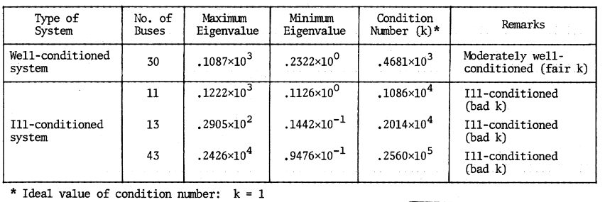
Convergence of Newton’s method for distribution systems
Condition number defines the condition of a matrix with respect to the computing problem. $λ_{max}(J)$ and $λ_{min}(J)$ are maximum and minimum eigenvalues of matrix $J$.
$$k\left(J\right)=\frac{λ_{max}(J)}{λ_{min}(J)}$$
A very high value of the condition number of matrix $J$indicates that:
The system is ill-conditioned, the computed values are very sensitive to small changes in input values.
The matrix $J$is invertible.
Tab.1 Maximum and Minimum Eigenvalues and Condition Number [2]
[2] S. C. Tripathy and G. S. S. S. K. Purge Prasad, "Load flow solution for ill-conditioned power systems by quadratically convergent Newton-like method," in IEE Proceedings C - Generation, Transmission and Distribution, vol. 127, no. 5, pp. 273-280, September 1980.

Slide 11
Forward/Backward Sweep-based Algorithm
Methods developed for the solution of ill-conditioned radial distribution systems may be divided into two categories [3]:
Forward and/or backward sweep
Kirchhoff’s formulation
BIBC & BCBV
Quadratic equation-based algorithm
Dist-Flow
Modification of existing methods
Modified N-R method
Forward/backward sweep-based power flow algorithm generally takes advantage of the radial network topology and consists of forward and backward sweep processes.
The forward sweep is mainly the node voltage calculation from the sending end to the far end of the lines.
The backward sweep is primarily the branch current or power summation from the far end to the sending end of the lines.
[3] U. Eminoglu & M. H. Hocaoglu, “Distribution Systems Forward/ Backward Sweep-based Power Flow Algorithms: A Review and Comparison Study’, in Electric Power Components and Systems, 37:1, 91-110, 2008

Slide 12
Forward/Backward Sweep-based Algorithm
Fig.1 shows a linear ladder network [4].
For the ladder network, it is assumed that all of the line impedances and load impedances are known along with the voltage (V_{S}) at the source.
The solution for this network is to perform the “forward” sweep by calculating the voltage at node 5 (V₅) under a no-load condition.
With no load currents there are no line currents, so the computed voltage at node 5 will equal that of the specified voltage at the source.
The “backward” sweep commences by computing the load current at node 5.
The load current I₅ is
$$I_{5}=\frac{V_{5}}{{ZL}_{5}}$$
Fig.3 Linear Ladder network [4]
[4] Kersting, William H. Distribution system modeling and analysis 4th edition. CRC press, 2017.

Slide 13
Forward/Backward Sweep-based Algorithm
For this “end node” case, the line current I₄₅ is equal to the load current I₅. The “backward” sweep continues by applying Kirchhoff's voltage law (KVL) to calculate the voltage at node 4:
$I_{45}$=$I_{5}$
$$V_{4}=V_{5}+Z_{45}∙I_{45}$$
The load current I₄ can be determined and then Kirchhoff's current law (KCL) applied to determine the line current I₃₄:
$$I_{4}=\frac{V_{4}}{{ZL}_{4}}$$
$$I_{34}=I_{45}+I_{4}$$
KVL is applied to determine the node voltage V₃. The backward sweep continues until a voltage (V₁) has been computed at the source.
$$V_{3}=V_{4}+Z_{34}∙I_{34}$$
…
Fig.3 Linear Ladder network [4]
$$V_{1}$$
[4] Kersting, William H. Distribution system modeling and analysis 4th edition. CRC press, 2017.

Slide 14
Forward/Backward Sweep-based Algorithm
The computed voltage V₁ is compared to the specified voltage V_{S}. There will be a difference between these two voltages. The ratio of the specified voltage to the compute voltage can be determined as
$$Ratio=\frac{V_{S}}{V_{1}}$$
Since the network is linear, all of the line and load currents and node voltages in the network can be multiplied by the ratio for the final solution to the network.
Fig.3 Linear Ladder network [4]
[4] Kersting, William H. Distribution system modeling and analysis 4th edition. CRC press, 2017.

Slide 15
Forward/Backward Sweep-based Algorithm
The linear network of Fig.3 is modified to a nonlinear network by replacing all of the constant load impedances by constant complex power loads as shown in Fig.4.
As with the linear network, the “forward” sweep computes the voltage at node 5 assuming no load. As before, the node 5 (end node) voltage will equal that of the specified source voltage. In general, the load current at each node is computed by
$$I_{n}={\left(\frac{S_{n}}{V_{n}}\right)}^{∗}$$
Fig. 4 Nonlinear ladder network [4]
[4] Kersting, William H. Distribution system modeling and analysis 4th edition. CRC press, 2017.

Slide 16
Forward/Backward Sweep-based Algorithm
The “backward” sweep will determine a computed source voltage V₁.
As in the linear case, this first “iteration” will produce a voltage that is not equal to the specified source voltage V_{S}. Because the network is nonlinear, multiplying currents and voltages by the ratio of the specified voltage to the computed voltage will not give the solution.
The most direct modification using the ladder network theory is to perform a “forward” sweep. The forward sweep commences by using the specified source voltage and the line currents from the previous “backward” sweep. KVL is used to compute the voltage at node 2 by
$$V_{2}=V_{s}−Z_{12}∙I_{12}$$
Fig. 4 Nonlinear ladder network [4]
[4] Kersting, William H. Distribution system modeling and analysis 4th edition. CRC press, 2017.

Slide 17
Forward/Backward Sweep-based Algorithm
This procedure is repeated for each line segment until a “new” voltage is determined at node 5.
Using the “new” voltage at node 5, a second backward sweep is started that will lead to a “new” computed voltage at the source.
The procedure shown earlier works but, in general, will require more time to converge. A modified version is to perform the “forward” sweep calculating all of the node voltages using the line currents from the previous “backward” sweep.
The new “backward” sweep will use the node voltages from the previous “forward” sweep to compute the new load and line currents.
In general, this modification will require more iterations but less time to converge. In this modified version of the ladder technique, convergence is determined by computing the ratio of difference between the voltages at the n − 1 and n iterations and the nominal line-to-neutral voltage. Convergence is achieved when all of the phase voltages at all nodes satisfy
$$\frac{\left|\left|V_{n}\right|−\left|V_{n−1}\right|\right|}{V_{nomial}}≤Specified tolerance$$
[4] Kersting, William H. Distribution system modeling and analysis 4th edition. CRC press, 2017.

Slide 18
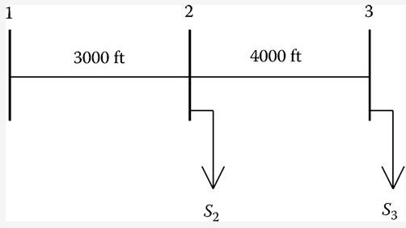
Example
Use the modified ladder method to compute the load voltage.
A single-phase lateral is shown in Fig.5. The line impedance is
$$z=0.3+j0.6 Ω/{mile}$$
The impedance of the line segment 1–2 is
$Z_{12}=\left(0.3+j0.6\right)$ $∙\frac{3000}{5280}=0.1705+j0.3409 Ω$
The impedance of the line segment 2–3 is
$Z_{23}=\left(0.3+j0.6\right)$ $∙\frac{4000}{5280}=0.2273+j0.4545 Ω$
Fig.5 Single-phase lateral [4]
[4] Kersting, William H. Distribution system modeling and analysis 4th edition. CRC press, 2017.

Slide 19
Example
The loads are
$$S_{2}=1500+j750 (kW+jkvar)$$
$$S_{3}=900+j500 (kW+jkvar)$$
The source voltage at node 1 is 7200 V.
Set initial conditions:
$$I_{12}=I_{23}=0$$
$$V_{old}=0$$
$$Tol.=0.0001$$
The first forward sweep:
$V_{2}=V_{s}−Z_{12}∙I_{12}=$ $7200∠0$
$V_{3}=V_{2}−Z_{23}∙I_{23}=$ $7200∠0$
$$Error=\frac{\left|\left|V_{3}\right|−\left|V_{old}\right|\right|}{7200}=1 (greater than Tol, start backward sweep)$$
$$V_{old}=V_{3}$$
Fig.5 Single-phase lateral [4]
[4] Kersting, William H. Distribution system modeling and analysis 4th edition. CRC press, 2017.

Slide 20
Example
The first backward sweep:
$$I_{3}={\left(\frac{(900+j500)∙1000}{7200∠0}\right)}^{∗}=143.0∠−29.0 A$$
The current flowing in the line segment 2–3 is
$$I_{23}=I_{3}=143.0∠−29.0 A$$
The load current at node 2 is
$$I_{2}={\left(\frac{(1500+j750)∙1000}{7200∠0}\right)}^{∗}=232.9∠−27.5 A$$
The current in line segment 1–2 is
$$I_{12}=I_{23}+I_{2}=373.8∠−27.5 A$$
The second forward sweep:
$V_{2}=V_{2}−Z_{12}∙I_{12}=$7$084.5∠−0.7$
$V_{3}=V_{2}−Z_{23}∙I_{23}=$7$025.1∠−1.0$
$$Error=\frac{\left|\left|V_{3}\right|−\left|V_{old}\right|\right|}{7200}=\frac{\left|7084.5−7200\right|}{7200}=0.0243(greater than Tol, start backward sweep)$$
$$V_{old}=V_{3}$$
[4] Kersting, William H. Distribution system modeling and analysis 4th edition. CRC press, 2017.

Slide 21
Example
At this point, the second backward sweep is used to compute the new line currents. Then it is followed by the third forward sweep.
After four iterations, the voltages have converged to an error of 0.000017 with the final voltages and currents of
[$V_{2}$]$=$7$081.0∠−0.68$
[$V_{3}$]$=$7$019.3∠−1.02$
[$I_{12}$]$=$3$83.4∠−28.33$
[$I_{23}$]$=$1$46.7∠−30.07$
[4] Kersting, William H. Distribution system modeling and analysis 4th edition. CRC press, 2017.

Slide 22
Forward/Backward Sweep-based Algorithm
With reference to Fig.6, the forward and backward sweep equations are
Forward sweep:
$${[{VLN}_{abc}]}_{m}=\left[A\right]{∙[{VLN}_{abc}]}_{n}−\left[B\right]{∙[I_{abc}]}_{n}$$
Backward sweep:
$${[I_{abc}]}_{n}=\left[c\right]{∙[{VLN}_{abc}]}_{m}+\left[d\right]{∙[I_{abc}]}_{m}$$
It was also shown that for the grounded wye–delta transformer bank, the backward sweep equation is
$${[I_{abc}]}_{n}=\left[x_{t}\right]{∙[{VLN}_{abc}]}_{n}+\left[d\right]{∙[I_{abc}]}_{m}$$
Fig.6 Standard feeder series component model [4]
[4] Kersting, William H. Distribution system modeling and analysis 4th edition. CRC press, 2017.

Slide 23
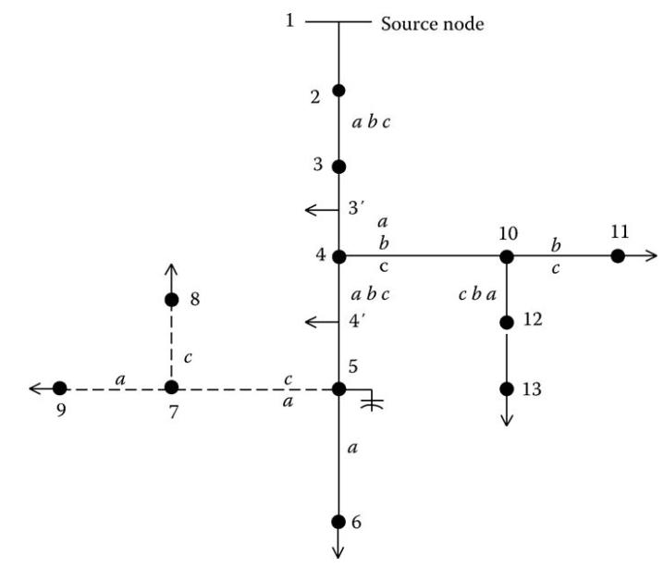
Forward/Backward Sweep-based Algorithm
In Fig. 7, nodes 4, 10, 5, and 7 are referred to as “junction nodes.”
In the forward sweep, the voltages at all nodes down the lines from the junction nodes must be computed.
In the backward sweeps, the currents at the junction nodes must be summed before proceeding toward the source.
In developing a program to apply the modified ladder method, it is necessary for the ordering of the lines and nodes to be such that all node voltages in the forward sweep are computed and all currents in the backward sweep are computed.
Fig.7 Typical distribution feeder [4]
[4] Kersting, William H. Distribution system modeling and analysis 4th edition. CRC press, 2017.

Slide 24
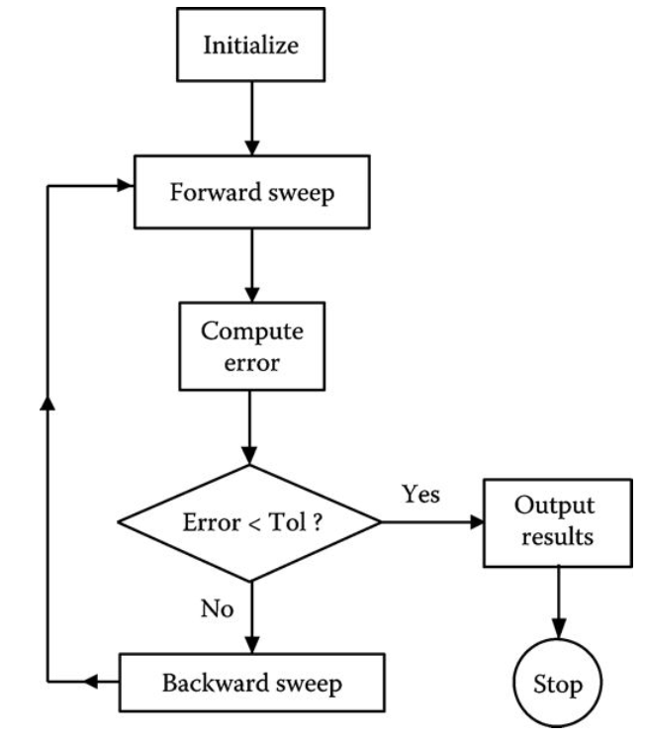
Forward/Backward Sweep-based Algorithm
A simple flowchart of the Forward/Backward sweep-based algorithm is shown in Fig.8.
$$I_{branch}^{(0)}=0$$
$$V_{bus}^{(0)}=1$$
$$\left|V_{bus}^{(k+1)}−V_{bus}^{(k)}\right|$$
Fig.8 Simple modified ladder flowchart [4]
[4] Kersting, William H. Distribution system modeling and analysis 4th edition. CRC press, 2017.

Slide 25
BIBC matrix and BCBV matrix
There are two matrices can be used to improve computational efficiency, which takes advantages of the topological characteristics of distribution systems and solves the distribution load flow [5]:
Bus Injection to Bus Current (BIBC) matrix: relationship between the bus current injections and branch currents
Branch current to Bus Voltage (BCBV) matrix: relationship between the branch currents and bus voltages
The reason why the BIBC and BCBV are applied:
In conventional forward/backward sweep method, the bus voltages and line currents are calculated segments by segments (with topological characteristics) in each iteration.
While by using the BIBC and BCBV, the two matrices are calculated only once and they have already included all topological information. BIBC/BCBV will not be updated in each iteration. Only voltage drop and branch currents will be updated.
[5] Jen-Hao Teng, "A direct approach for distribution system load flow solutions," in IEEE Transactions on Power Delivery, vol. 18, no. 3, pp. 882-887, July 2003.

Slide 26
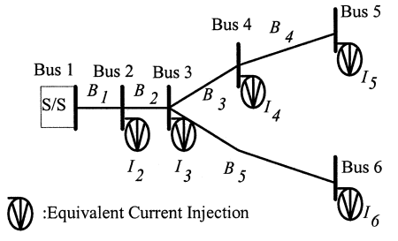
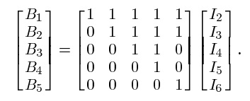
BIBC matrix and BCBV matrix
By using the KCL
$B_{1}=I_{2}$+$I_{3}$+$I_{4}$+$I_{5}$+$I_{6}$
$B_{3}=I_{4}$+$I_{5}$
$$B_{5}=I_{6}$$
Relationship between the bus current injections and branch currents
Fig.9 Equivalent Current Injection based Model of Distribution Network [5]
B is branch current
I is bus current injection
$$\left[B\right]=\left[BIBC\right]\left[I\right]$$
The constant BIBC matrix is an upper triangular matrix and contains values of 0 and 1 only.
[5] Jen-Hao Teng, "A direct approach for distribution system load flow solutions," in IEEE Transactions on Power Delivery, vol. 18, no. 3, pp. 882-887, July 2003.

Slide 27
BIBC matrix and BCBV matrix
To build BIBC matrix:
Step.1 For a distribution system with m-branch section and n-bus, the dimension of the BIBC matrix is $m×\left(n−1\right)$.
Step.2 If a line section is located between bus i and bus j, copy the column of the i-th bus of the BIBC matrix to the column of the j-th bus and fill a +1 to the position of the k-th row and the j-th bus column
Step.3 Repeat Step.2 until all line sections are included in the BIBC matrix
[5] Jen-Hao Teng, "A direct approach for distribution system load flow solutions," in IEEE Transactions on Power Delivery, vol. 18, no. 3, pp. 882-887, July 2003.

Slide 28
BIBC matrix and BCBV matrix
By using the KVL
$$V_{2}={V_{1}−B_{1}Z}_{12}$$
$$V_{3}={V_{2}−B_{2}Z}_{23}$$
$$V_{4}={V_{3}−B_{3}Z}_{34}$$
$$V_{4}={V_{1}−B_{1}Z}_{12}{−B_{2}Z}_{23}{−B_{3}Z}_{34}$$
Relationship between branch currents and bus voltages
Fig.10 Equivalent Current Injection based Model of Distribution Network [5]
V is bus voltage
Z is line impedance
[$∆V]=\left[BCBV\right]\left[B\right]$
The constant BIBC matrix is a lower triangular matrix and contains values of 0 and line impedance only.
[5] Jen-Hao Teng, "A direct approach for distribution system load flow solutions," in IEEE Transactions on Power Delivery, vol. 18, no. 3, pp. 882-887, July 2003.

Slide 29
BIBC matrix and BCBV matrix
To build BCBV matrix:
Step.1 For a distribution system with m-branch section and n-bus, the dimension of the BCBV matrix is $n×\left(m−1\right)$.
Step.2 If a line section is located between bus i and bus j, copy the column of the i-th bus of the BCBV matrix to the column of the j-th bus and fill the line impedance $Z_{ij}$ to the position of the j-th row and the k-th bus column.
Step.3 Repeat Step.2 until all line sections are included in the BCBV matrix.
[5] Jen-Hao Teng, "A direct approach for distribution system load flow solutions," in IEEE Transactions on Power Delivery, vol. 18, no. 3, pp. 882-887, July 2003.

Slide 30
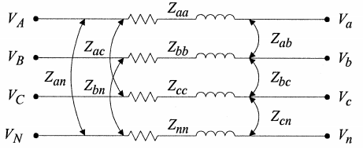
Three-phase BCBV matrix
The algorithm can easily be expanded to a multiphase line section or bus.
For example, if the line section between bus i and bus j is a three-phase line section, the corresponding branch current $B_{i}$ will be a $3×1$ vector and the in the BIBC matrix will be a $3×3$ identity matrix.
Similarly, if the line section between bus i and bus j is a three-phase line section, the $Z_{ij}$ in the BCBV matrix is a $3×3$ impedance matrix as follows.
$$\left[Z_{abc}\right]=\left[\begin{matrix}Z_{aa−n} & Z_{ab−n} & Z_{ac−n} \\ Z_{ba−n} & Z_{bb−n} & Z_{bc−n} \\ Z_{ca−n} & Z_{cb−n} & Z_{cc−n}\end{matrix}\right]$$
Fig.11 Three-phase line section model [5]
[5] Jen-Hao Teng, "A direct approach for distribution system load flow solutions," in IEEE Transactions on Power Delivery, vol. 18, no. 3, pp. 882-887, July 2003.

Slide 31
BIBC matrix and BCBV matrix
Distribution Load Flow (DLF) matrix is a multiplication matrix of BCBV and BIBC matrices.
$$\left[B\right]=\left[BIBC\right]\left[I\right]$$
[$∆V]=\left[BCBV\right]\left[B\right]$
Combine two steps into one
$[∆V]=\left[BCBV\right]\left[B\right]=\left[BCBV\right]\left[BIBC\right]\left[I\right]$=$\left[DLF\right]\left[I\right]$
The solution for distribution load flow can be updated and obtained iteratively as follows:
$$I_{i}^{k}=I_{i}^{k}V_{i}^{k}+jI_{i}^{k}V_{i}^{k}={\left(\frac{\left(P_{i}+jQ_{i}\right)}{V_{i}^{k}}\right)}^{∗}$$
The voltage drop on each branch is computed using the DLF and load currents.
The node voltages are computed by using the source bus voltage and voltage drops.
$$\left[∆V_{i}^{k+1}\right]=\left[DLF\right]\left[I_{i}^{k}\right]$$
$$\left[V_{i}^{k+1}\right]=\left[V^{0}\right]+\left[∆V_{i}^{k+1}\right]$$
[5] Jen-Hao Teng, "A direct approach for distribution system load flow solutions," in IEEE Transactions on Power Delivery, vol. 18, no. 3, pp. 882-887, July 2003.

Slide 32
BIBC matrix and BCBV matrix
Step.1 Input the radial system topology data
Step.2 Form the BIBC matrix
$$\left[BIBC\right]=\left[I\right]/\left[B\right]$$
Step.3 Form the BCBV matrix
$\left[BCBV\right]=\left[B\right]$ $/[∆V]$
Step.4 Calculate DLF matrix and set iteration k=0
$$\left[DLF\right]=\left[BCBV\right]\left[BIBC\right]$$
[5] Jen-Hao Teng, "A direct approach for distribution system load flow solutions," in IEEE Transactions on Power Delivery, vol. 18, no. 3, pp. 882-887, July 2003.

Slide 33
BIBC matrix and BCBV matrix
Step.4 Calculate DLF matrix and set iteration k=0
$$\left[DLF\right]=\left[BCBV\right]\left[BIBC\right]$$
Step.5 Update voltage and iteration k=k+1
$$I_{i}^{k}=I_{i}^{k}V_{i}^{k}+jI_{i}^{k}V_{i}^{k}={\left(\frac{\left(P_{i}+jQ_{i}\right)}{V_{i}^{k}}\right)}^{∗}$$
$$\left[∆V_{i}^{k+1}\right]=\left[DLF\right]\left[I_{i}^{k}\right]$$
$$\left[V_{i}^{k+1}\right]=\left[V^{0}\right]+\left[∆V_{i}^{k+1}\right]$$
Step.6 If $\left(\left|V_{i}^{k+1}\right|−\left|V_{i}^{k}\right|\right)<$ tolerance, go to next step; else, go back to Step. 5
Step.7 Calculate line flows and power losses using final voltage
[5] Jen-Hao Teng, "A direct approach for distribution system load flow solutions," in IEEE Transactions on Power Delivery, vol. 18, no. 3, pp. 882-887, July 2003.

Slide 34
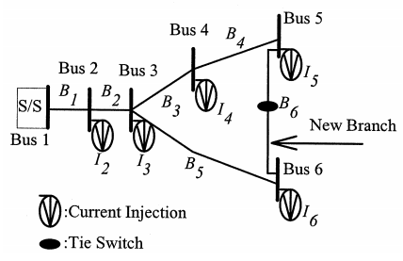
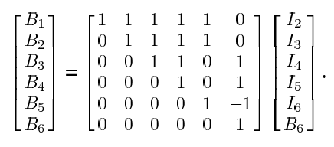
BIBC matrix and BCBV matrix
Some distribution feeders serve high-density load areas and contain loops. The proposed method introduced before can be extended for “weakly-meshed” distribution feeders.
Modification for BIBC matrix:
Taking the new branch current into account, the current injections of bus 5 and bus 6 will be:
$$I_{5}^{′}=I_{5}+B_{6}$$
$$I_{6}^{′}=I_{6}−B_{6}$$
Fig.12 Simple distribution system with one loop [5]
$$\left[\begin{aligned}B \\ B_{new}\end{aligned}\right]=\left[BIBC\right]\left[\begin{aligned}I \\ B_{new}\end{aligned}\right]$$
[5] Jen-Hao Teng, "A direct approach for distribution system load flow solutions," in IEEE Transactions on Power Delivery, vol. 18, no. 3, pp. 882-887, July 2003.

Slide 35
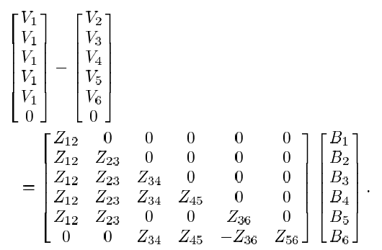
BIBC matrix and BCBV matrix
Modification for BCBV matrix:
Considering the loop shown in Fig. 12, KVL for this loop can be written as:
$${B_{3}Z}_{34}{+B_{4}Z}_{45}{+B_{6}Z}_{56}{−B_{5}Z}_{36}=0$$
The new BCBV matrix is:
$$\left[\begin{aligned}∆V \\ 0\end{aligned}\right]=\left[BCBV\right]\left[\begin{aligned}B \\ B_{new}\end{aligned}\right]$$
Fig.12 Simple distribution system with one loop [5]
[5] Jen-Hao Teng, "A direct approach for distribution system load flow solutions," in IEEE Transactions on Power Delivery, vol. 18, no. 3, pp. 882-887, July 2003.

Slide 36
BIBC matrix and BCBV matrix
Modification for solution techniques:
$$\left[\begin{aligned}∆V \\ 0\end{aligned}\right]=\left[BCBV\right]\left[\begin{aligned}B \\ B_{new}\end{aligned}\right]$$
$\left[\begin{aligned}∆V \\ 0\end{aligned}\right]=\left[BCBV\right]\left[BIBC\right]\left[\begin{aligned}I \\ B_{new}\end{aligned}\right]$=$\left[\begin{matrix}A & M^{T} \\ M & N\end{matrix}\right]\left[\begin{aligned}I \\ B_{new}\end{aligned}\right]$
$$\left[\begin{aligned}B \\ B_{new}\end{aligned}\right]=\left[BIBC\right]\left[\begin{aligned}I \\ B_{new}\end{aligned}\right]$$
The modified algorithm for weakly meshed networks can be expressed as
$$\left[∆V\right]=\left[A−M^{T}N^{−1}M\right]\left[I\right]=\left[DLF\right]\left[I\right]$$
Except for some modifications needed to be done for the BIBC, BCBV, and DLF matrices, the proposed solution techniques require no modification.
[5] Jen-Hao Teng, "A direct approach for distribution system load flow solutions," in IEEE Transactions on Power Delivery, vol. 18, no. 3, pp. 882-887, July 2003.

Slide 37
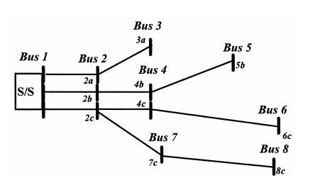
BIBC matrix and BCBV matrix
The proposed three-phase load flow algorithm was implemented on an 8-bus distribution system. Two methods are used for tests and the convergence tolerance is set at 0.001.
Method 1: The Gauss implicit Z-matrix method
Method 2: The proposed algorithm with BIBC and BCBV
Fig.13 A 8-bus radial distribution system [5]
[5] Jen-Hao Teng, "A direct approach for distribution system load flow solutions," in IEEE Transactions on Power Delivery, vol. 18, no. 3, pp. 882-887, July 2003.

Slide 38
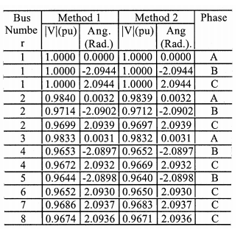
BIBC matrix and BCBV matrix
The final voltage solutions of method 1 and method 2 are shown in Tab.2.
From Tab.2, the final converged voltage solutions of method 2 are very close to the solution of method 1.
It means that the accuracy of the proposed method is almost the same as the commonly used Gauss implicit -matrix method.
Tab. 2 Final Converged Voltage Solutions [5]
[5] Jen-Hao Teng, "A direct approach for distribution system load flow solutions," in IEEE Transactions on Power Delivery, vol. 18, no. 3, pp. 882-887, July 2003.

Slide 39
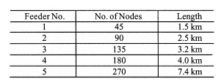
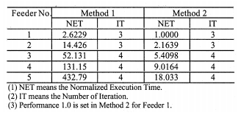
BIBC matrix and BCBV matrix
Tab.4 lists the number of iterations and the normalized execution time for both methods. It can be seen that method 2 is more efficient, especially when the network size increases,
It is because the time-consuming processes such as LU factorization and forward/backward substitution of Y-bus matrix are not necessary for method 2.
Tab. 3 Test Feeder [5]
Tab. 4 Number of iteration and Normalized Execution Time [5]
[5] Jen-Hao Teng, "A direct approach for distribution system load flow solutions," in IEEE Transactions on Power Delivery, vol. 18, no. 3, pp. 882-887, July 2003.

Slide 40
Node voltage calculations (quadratic equation)
The quadratic equation relates the voltage magnitude at the receiving end to the branch power and the voltage at the sending end.
Let us consider a distribution line model as below, the real and reactive power at the receiving end can be written as
$$P_{r}=\frac{V_{s}V_{r}}{Z}\cos\left(θ_{z}−δ_{s}+δ_{r}\right)−\frac{V_{r}^{2}}{Z}cos⁡(θ_{z})$$
$V_{r}^{4}+2V_{r}^{2}$($P_{r}$R+$Q_{r}$X)$−$ $V_{s}^{2}V_{r}^{2}$ $+$($P_{r}^{2}$ $+ Q_{r}^{2}$)$Z^{2}=0$
$$Q_{r}=\frac{V_{s}V_{r}}{Z}\sin\left(θ_{z}−δ_{s}+δ_{r}\right)−\frac{V_{r}^{2}}{Z}sin⁡(θ_{z})$$
Node voltages are calculated by solving this quadratic equation
$V_{r}^{2}$=$\sqrt{V_{s}^{2}−2\text{(}P_{r}\text{R}\text{+}Q_{r}\text{X}\text{)}+\frac{\text{(}P_{r}^{2} + Q_{r}^{2}\text{)}Z^{2}}{V_{s}^{2}}}$
$$\cos\left(θ_{z}−δ_{s}+δ_{r}\right)=\frac{P_{r}Z}{V_{s}V_{r}}+\frac{V_{s}V_{r}}{V_{s}}cos⁡(θ_{z})$$
$$\sin\left(θ_{z}−δ_{s}+δ_{r}\right)=\frac{Q_{r}Z}{V_{s}V_{r}}+\frac{V_{s}V_{r}}{V_{s}}sin⁡(θ_{z})$$
$\cos^{2}\left(θ_{z}−δ_{s}+δ_{r}\right)$+$\sin^{2}\left(θ_{z}−δ_{s}+δ_{r}\right)$=1
Fig.14A two-bus distribution network [3]
[3] U. Eminoglu & M. H. Hocaoglu, “Distribution Systems Forward/ Backward Sweep-based Power Flow Algorithms: A Review and Comparison Study’, in Electric Power Components and Systems, 37:1, 91-110, 2008

Slide 41
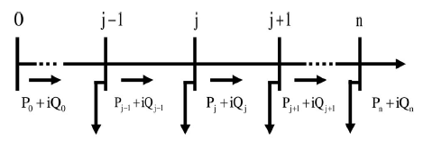
Dist-Flow method (single phase)
Nodal Voltage ($V_{j+1}$) on Bus j+1:
$V_{j+1}^{2}=V_{j}^{2}−$2$\left(r_{j}P_{j}+x_{j}Q_{j}\right)+\left(r_{j}^{2}+x_{j}^{2}\right)\frac{P_{j}^{2}+Q_{j}^{2}}{V_{j}^{2}}$
Active ($P_{j+1}$) and Reactive ($Q_{j+1}$) Branch Power Flow from Bus j to Bus j+1:
$$P_{j+1}=P_{j}−p_{j+1}−r_{j}\frac{P_{j}^{2}+Q_{j}^{2}}{V_{j}^{2}}$$
$$Q_{j+1}=Q_{j}−q_{j+1}−x_{j}\frac{P_{j}^{2}+Q_{j}^{2}}{V_{j}^{2}}$$
$$p_{j+1}=p_{j+1}^{(c)}\text{−}p_{j+1}^{(g)}$$
$$q_{j+1}=q_{j+1}^{(c)}\text{−}q_{j+1}^{(g)}$$
$p_{j+1}^{(c)},q_{j+1}^{(c)}$: Power consumptions at Bus j+1
$p_{j+1}^{(g)},q_{j+1}^{(g)}$: Power generations at Bus j+1
$r_{j},x_{j}$: Complex impedance of the line between Bus j to Bus j+1
$r_{j}\frac{P_{j}^{2}+Q_{j}^{2}}{V_{j}^{2}},x_{j}\frac{P_{j}^{2}+Q_{j}^{2}}{V_{j}^{2}}$: Active and reactive power losses of the line between Bus j to Bus j+1
$$p_{j}+iq_{j}$$
$$p_{j+1}+iq_{j+1}$$
Fig.15 Dist-Flow Demonstration [6]
[6] Q. Zhang, K. Dehghanpour and Z. Wang, "Distributed CVR in Unbalanced Distribution Systems With PV Penetration," in IEEE Transactions on Smart Grid, vol. 10, no. 5, pp. 5308-5319, Sept. 2019.

Slide 42
Dist-Flow method (single phase)
Forward nodal voltage calculation:
$V_{j+1}^{2}=V_{j}^{2}−$2$\left(r_{j}P_{j}+x_{j}Q_{j}\right)+\left(r_{j}^{2}+x_{j}^{2}\right)\frac{P_{j}^{2}+Q_{j}^{2}}{V_{j}^{2}}$
Backward branch power flow and branch power loss calculation:
$$P_{j+1}=P_{j}−p_{j+1}−r_{j}\frac{P_{j}^{2}+Q_{j}^{2}}{V_{j}^{2}}$$
$$Q_{j+1}=Q_{j}−q_{j+1}−x_{j}\frac{P_{j}^{2}+Q_{j}^{2}}{V_{j}^{2}}$$
The calculation is ended when certain values (for example, bus voltages or the system’s total active and reactive power loss mismatches) are lower than a specified error value.

Slide 43
Linearized Dist-Flow method (single phase)
The branch power flow and voltage constraints in Dist-Flow method have power loss terms ($\frac{P_{i}^{2}+Q_{i}^{2}}{V_{i}^{2}}$) that make the problem nonlinear.
There are several methods to linearize the nonlinear power loss terms:
(1) Neglect the nonlinear terms
The linearization is based on the fact that the nonlinear terms are much smaller than the linear terms. So that the nonlinear terms are neglected for the sake of developing efficient solution algorithms.
However, it is noted that such linearization neglects an accurate calculation of power loss.
$$P_{i+1}=P_{i}−p_{i+1}−r_{i}\frac{P_{i}^{2}+Q_{i}^{2}}{V_{i}^{2}}$$
$$P_{i+1}=P_{i}−p_{i+1}$$
$$Q_{i+1}=Q_{i}−q_{i+1}−x_{i}\frac{P_{i}^{2}+Q_{i}^{2}}{V_{i}^{2}}$$
$$Q_{i+1}=Q_{i}−q_{i+1}$$
$V_{i+1}^{2}=V_{i}^{2}−$2$\left(r_{i}P_{i}+x_{i}Q_{i}\right)+\left(r_{i}^{2}+x_{i}^{2}\right)\frac{P_{i}^{2}+Q_{i}^{2}}{V_{i}^{2}}$
$V_{i+1}^{2}=V_{i}^{2}−$2$\left(r_{i}P_{i}+x_{i}Q_{i}\right)$

Slide 44
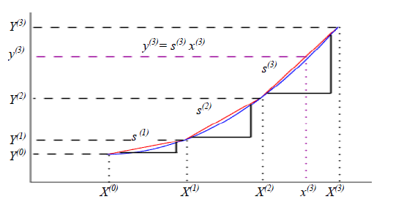
Fully Linearized Dist-Flow method (single phase)
(2) Piecewise linear formulation (more accurate)
The quadratic calculation of branch active power losses ($P_{i}^{loss}=r_{i}\frac{P_{i}^{2}+Q_{i}^{2}}{V_{i}^{2}}$) and reactive power losses (${Q_{i}^{loss}=x}_{i}\frac{P_{i}^{2}+Q_{i}^{2}}{V_{i}^{2}}$) can be linearized through piecewise linear formulation.
$$f_{i}\left(x\right)=\frac{R_{i}}{V_{0}^{2}}x^{2}$$
$$a_{ik}=\frac{f_{i}\left(P_{i}^{(k)}\right)−f_{i}\left(P_{i}^{(k−1)}\right)}{P_{i}^{(k)}−P_{i}^{(k−1)}}$$
$$g_{i}\left(x\right)=\frac{X_{i}}{V_{0}^{2}}x^{2}$$
$$b_{il}=\frac{f_{i}\left(Q_{i}^{(l)}\right)−f_{i}\left(Q_{i}^{(l−1)}\right)}{Q_{i}^{(l)}−Q_{i}^{(l−1)}}$$
Linear equation slopes
$$c_{ik}=\frac{g_{i}\left(P_{i}^{(k)}\right)−g_{i}\left(P_{i}^{(k−1)}\right)}{P_{i}^{(k)}−P_{i}^{(k−1)}}$$
Fig.16 Piecewise Linear Formulation [7]
$$d_{il}=\frac{g_{i}\left(Q_{i}^{(l)}\right)−g_{i}\left(Q_{i}^{(l−1)}\right)}{Q_{i}^{(l)}−Q_{i}^{(l−1)}}$$
[7] C. Zhang, Y. Xu, Z. Dong and J. Ravishankar, "Three-Stage Robust Inverter-Based Voltage/Var Control for Distribution Networks With High-Level PV," in IEEE Transactions on Smart Grid, vol. 10, no. 1, pp. 782-793, Jan. 2019.

Slide 45
Fully Linearized Dist-Flow method (single phase)
Linear calculation for the complex power loss:
$$P_{i}^{loss}=\sum_{k∈K_{i}}{a_{i,k}\left(P_{i,k}−P_{i,k}^{∗}\right)+\sum_{l∈L_{i}}{b_{i,l}\left(Q_{i,l}−Q_{i,l}^{∗}\right)}}$$
$$Q_{i}^{loss}=\sum_{k∈K_{i}}{c_{i,k}\left(P_{i,k}−P_{i,k}^{∗}\right)+\sum_{l∈L_{i}}{d_{i,l}\left(Q_{i,l}−Q_{i,l}^{∗}\right)}}$$
Piecewise power flow variable can vary only within its corresponding interval:
0${≤P}_{i,k}≤P_{i}^{\left(k\right)}−P_{i}^{(k−1)}$
0${≤Q}_{i,k}≤Q_{i}^{\left(l\right)}−Q_{i}^{(l−1)}$
$P_{i}^{\left(k−1\right)}−P_{i}^{(k)}≤P_{i,k}^{∗}≤$0
$Q_{i}^{\left(l−1\right)}−Q_{i}^{(k)}≤Q_{i,l}^{∗}≤$0
Based on the piecewise linear formulation, the fully linearized Dist-Flow with power loss is developed as:
$$P_{i+1}=P_{i}−p_{i+1}−r_{i}\frac{P_{i}^{2}+Q_{i}^{2}}{V_{i}^{2}}$$
$$P_{i+1}=P_{i}−p_{i+1}−P_{i}^{loss}$$
$$Q_{i+1}=Q_{i}−q_{i+1}−x_{i}\frac{P_{i}^{2}+Q_{i}^{2}}{V_{i}^{2}}$$
$$Q_{i+1}=Q_{i}−q_{i+1}−Q_{i}^{loss}$$
[7] C. Zhang, Y. Xu, Z. Dong and J. Ravishankar, "Three-Stage Robust Inverter-Based Voltage/Var Control for Distribution Networks With High-Level PV," in IEEE Transactions on Smart Grid, vol. 10, no. 1, pp. 782-793, Jan. 2019.

Slide 46
Extension to unbalanced three-phase systems
Up to this point, it has only considered the single phase; however, distribution networks are inherently three-phase unbalanced.
Also, the coupling between phases for the system voltages requires additional approximations to simplify the unbalanced case.
Formulations are developed by L. Gan and S. Low at Caltech (Patent number: US20150346753A1) [8]:
$$\left[\begin{aligned}{\left(V_{j}^{a}\right)}^{2} \\ {\left(V_{j}^{b}\right)}^{2} \\ {\left(V_{j}^{c}\right)}^{2}\end{aligned}\right]−\left[\begin{aligned}{\left(V_{i}^{a}\right)}^{2} \\ {\left(V_{i}^{b}\right)}^{2} \\ {\left(V_{i}^{c}\right)}^{2}\end{aligned}\right]+2\left[\begin{aligned}&P_{ij}^{a}{\tilde{R}}_{aa}+P_{ij}^{b}{\tilde{R}}_{ab}+P_{ij}^{c}{\tilde{R}}_{ac}+Q_{ij}^{a}{\tilde{X}}_{aa}+Q_{ij}^{b}{\tilde{X}}_{ab}+Q_{ij}^{c}{\tilde{X}}_{ac} \\ &P_{ij}^{a}{\tilde{R}}_{ba}+P_{ij}^{b}{\tilde{R}}_{bb}+P_{ij}^{c}{\tilde{R}}_{bc}+Q_{ij}^{a}{\tilde{X}}_{ba}+Q_{ij}^{b}{\tilde{X}}_{bb}+Q_{ij}^{c}{\tilde{X}}_{bc} \\ &P_{ij}^{a}{\tilde{R}}_{ca}+P_{ij}^{b}{\tilde{R}}_{cb}+P_{ij}^{c}{\tilde{R}}_{cc}+Q_{ij}^{a}{\tilde{X}}_{ca}+Q_{ij}^{b}{\tilde{X}}_{cb}+Q_{ij}^{c}{\tilde{X}}_{cc}\end{aligned}\right]=0$$
[8] Gan, Lingwen, and Steven H. Low. "Systems and Methods for Convex Relaxations and Linear Approximations for Optimal Power Flow in Multiphase Radial Networks." U.S. Patent Application No. 14/724,757.

Slide 47
Extension to unbalanced three-phase systems
In single-phase distribution system, it has
$$V_{j}=V_{i}−z_{ik}\frac{P_{ij}−jQ_{ij}}{V_{i}^{∗}}$$
Extend to three-phase system, it has
$${S_{ij}^{φ}}^{∗}=P_{ij}^{φ}−jQ_{ij}^{φ}$$
$$V_{j}^{φ}=V_{i}^{φ}−z_{ij}^{φ}\left[{S_{ij}^{φ}}^{∗}∅{V_{i}^{φ}}^{∗}\right]$$
Where $V_{i}^{φ}={\left[V_{i}^{a},V_{i}^{b},V_{i}^{c}\right]}^{T}$, $V_{j}^{φ}={\left[V_{j}^{a},V_{j}^{b},V_{j}^{c}\right]}^{T}$, $P_{ij}^{φ}={\left[P_{ij}^{a},P_{ij}^{b},P_{ij}^{c}\right]}^{T}$, $Q_{ij}^{φ}={\left[Q_{ij}^{a},Q_{ij}^{b},Q_{ij}^{c}\right]}^{T}$, $z_{ij}^{φ}∈∁^{3×3}$
$∅$ and $⨀$ denote the element-wise division multiplication, respectively.
Unlike the per-phase equivalent case, multiplying by the complex conjugate of both side of the three-phase formulation will not remove the dependence on $θ$.
This is due to the fact that there is a coupling between the phase at bus i that arises from the cross-products of the three-phase equations for the phase voltage and line current.
[9] Anmar Arif, “Distribution system outage management after extreme weather events”, PhD Dissertation, Iowa State University, 2019.

Slide 48
Extension to unbalanced three-phase systems
To address this problem, it has observed that the voltage magnitude between the phases are similar, i.e., $\left|V_{i}^{a}\right|≈\left|V_{i}^{b}\right|≈\left|V_{i}^{c}\right|$, and that the phase unbalances on each bus are not very severe, so it assumes that the voltages are nearly balanced. Thus, it can approximate the phase different at bus i as:
$$\cos\left(θ_{i}^{a}−θ_{i}^{b}\right)=\cos\left(\frac{2}{3}π+θ^{∗}\right)=−\frac{1}{2}\cos\left(θ^{∗}\right)−\frac{\sqrt{3}}{2}\sin\left(θ^{∗}\right)≈−\frac{1}{2}$$
$$\sin\left(θ_{i}^{a}−θ_{i}^{b}\right)=\sin\left(\frac{2}{3}π+θ^{∗}\right)=\frac{1}{2}\cos\left(θ^{∗}\right)+\frac{\sqrt{3}}{2}\sin\left(θ^{∗}\right)≈\frac{\sqrt{3}}{2}$$
Where $θ^{∗}$represents the relative phase unbalance, which is sufficiently small. Therefore, the nearly balanced voltages are
$$\frac{V_{i}^{a}}{V_{i}^{b}}≈\frac{V_{i}^{b}}{V_{i}^{c}}≈\frac{V_{i}^{c}}{V_{i}^{a}}≈e^{j{2π}/3}$$
[9] Anmar Arif, “Distribution system outage management after extreme weather events”, PhD Dissertation, Iowa State University, 2019.

Slide 49
Extension to unbalanced three-phase systems
It can update the voltage magnitude in Dist-Flow method for the unbalanced case with
$$\left[\begin{matrix}{\left|V_{j}^{a}\right|}^{2} \\ {\left|V_{j}^{b}\right|}^{2} \\ {\left|V_{j}^{c}\right|}^{2}\end{matrix}\right]=\left[\begin{matrix}{\left|V_{i}^{a}\right|}^{2} \\ {\left|V_{i}^{b}\right|}^{2} \\ {\left|V_{i}^{c}\right|}^{2}\end{matrix}\right]−{\tilde{z}}_{ij}S_{ij}^{∗}−{\tilde{z}}_{ij}^{∗}S_{ij}$$
where
$$S_{ij}=\left[\begin{matrix}P_{ij}^{a}+jQ_{ij}^{a} \\ P_{ij}^{b}+jQ_{ij}^{b} \\ P_{ij}^{c}+jQ_{ij}^{c}\end{matrix}\right]$$
$${\tilde{z}}_{ij}=α⊙z_{ij}=\left[\begin{matrix}1 & e^{−j{2π}/3} & e^{j{2π}/3} \\ e^{j{2π}/3} & 1 & e^{−j{2π}/3} \\ e^{−j{2π}/3} & e^{j{2π}/3} & 1\end{matrix}\right]⊙\left[\begin{matrix}z_{ij}^{aa} & z_{ij}^{ab} & z_{ij}^{ac} \\ z_{ij}^{ba} & z_{ij}^{bb} & z_{ij}^{bc} \\ z_{ij}^{ca} & z_{ij}^{cb} & z_{ij}^{cc}\end{matrix}\right]$$
$α$is Phase shift matrix
[9] Anmar Arif, “Distribution system outage management after extreme weather events”, PhD Dissertation, Iowa State University, 2019.

Slide 50
Extension to unbalanced three-phase systems
Apply above equations to Dist-Flow formulation to for the extension to unbalanced three-phase systems.
$$P_{j}^{φ}=P_{i}^{φ}−p_{i}^{φ}−r_{ij}^{φ}\frac{{\left(P_{i}^{φ}\right)}^{2}+{\left(Q_{i}^{φ}\right)}^{2}}{{\left(V_{i}^{φ}\right)}^{2}}$$
$$Q_{j}^{φ}=Q_{i}^{φ}−q_{i}^{φ}−z_{ij}^{φ}\frac{{\left(P_{i}^{φ}\right)}^{2}+{\left(Q_{i}^{φ}\right)}^{2}}{{\left(V_{i}^{φ}\right)}^{2}}$$
$r_{ij}^{φ}$=real($α⊙z_{ij}$)
$z_{ij}^{φ}$=imag($α⊙z_{ij}$)
[9] Anmar Arif, “Distribution system outage management after extreme weather events”, PhD Dissertation, Iowa State University, 2019.

Slide 51
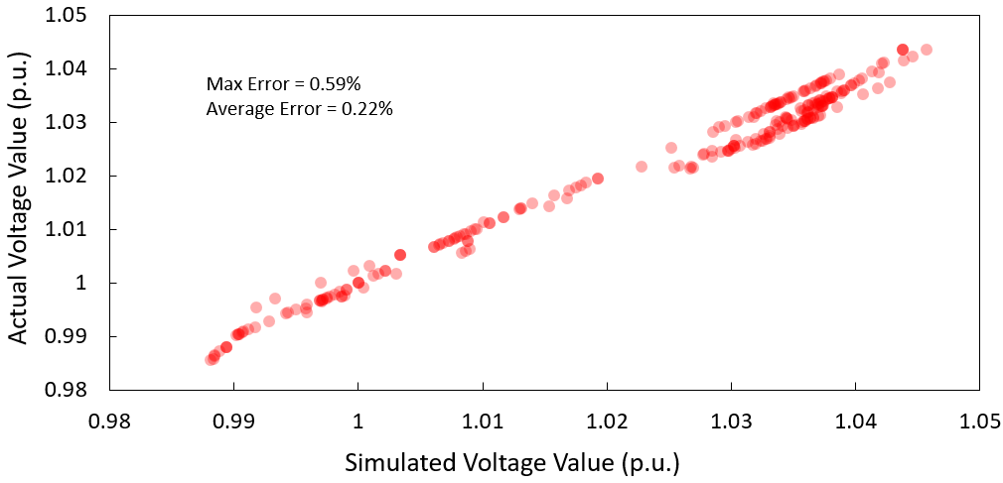
Validation
In [9], the validation of this unbalanced approximation method VS OpenDSS simulated results.
Fig.17 IEEE 123-bus system: actual vs simulated results [9]
[9] Anmar Arif, “Distribution system outage management after extreme weather events”, PhD Dissertation, Iowa State University, 2019.

Slide 52
Power flow in OpenDSS
However, OpenDSS manual [10] says that:
[10] “Reference guide: The OpenDSS”, [online]: https://www.epri.com/#/pages/sa/opendss?lang=en

Slide 53
Modified Newton-Raphson method
In [11], A modified Newton method for radial distribution system is derived in which the Jacobian matrix is in $UDU^{T}$ form, where $U$ is a constant upper triangular matrix depending only on system topology and $D$ is a block diagonal matrix. With this formulation, the conventional steps of forming the Jacobian matrix are replaced by back/forward sweeps on radial feeders with equivalent impedances.
In conventional Newton-Raphson method, the power flow problem is to solve
where
$$\left[\begin{matrix}H & N \\ J & L\end{matrix}\right]\left[\begin{matrix}∆θ \\ ∆V/V\end{matrix}\right]=\left[\begin{matrix}∆P \\ ∆Q\end{matrix}\right]$$
$$H_{ij}=−V_{i}V_{j}\left(G_{ij}\sin{θ_{ij}}−B_{ij}\cos{θ_{ij}}\right), j≠i$$
$$H_{ii}=V_{i}\sum_{j∈N_{i},j≠i }{V_{j}\left(G_{ij}\sin{θ_{ij}}−B_{ij}\cos{θ_{ij}}\right)}$$
$$N_{ij}=−V_{i}V_{j}\left(G_{ij}\cos{θ_{ij}}+B_{ij}\sin{θ_{ij}}\right), j≠i$$
$$N_{ii}=−V_{i}\sum_{j∈N_{i},j≠i }{V_{j}\left(G_{ij}\cos{θ_{ij}}+B_{ij}\sin{θ_{ij}}\right)−2V_{i}^{2}}G_{ii}$$
$$J_{ij}=V_{i}V_{j}\left(G_{ij}\cos{θ_{ij}}+B_{ij}\sin{θ_{ij}}\right), j≠i$$
$$J_{ii}={−V}_{i}\sum_{j∈N_{i},j≠i }{V_{j}\left(G_{ij}\cos{θ_{ij}}+B_{ij}\sin{θ_{ij}}\right)}$$
$$L_{ij}=−V_{i}V_{j}\left(G_{ij}\sin{θ_{ij}}−B_{ij}\cos{θ_{ij}}\right), j≠i$$
$$L_{ii}=−V_{i}\sum_{j∈N_{i},j≠i }{V_{j}\left(G_{ij}\sin{θ_{ij}}−B_{ij}\cos{θ_{ij}}\right)+2V_{i}^{2}}B_{ii}$$
[11] F. Zhang and C. S. Cheng, “A Modified Newton Method for Radial Distribution System Power Flow Analysis," in IEEE Transactions on Power System, vol. 12, no. 1, pp. 882-887, Feb 1997.

Slide 54
Modified Newton-Raphson method
Assumption 1: small voltage difference between two adjacent nodes (typical distribution lines are short and line flows are not high).
Assumption 2: no shunt branches (all the shunt branches can be converted to node power injections using initial and updated node voltages).
Therefore, the Jacobian matrix can be approximated as:
$$H_{ii}≈{−V}_{i}\sum_{j∈N_{i},j≠i }{V_{j}\left(B_{ij}\cos{θ_{ij}}\right)}$$
$$H_{ij}≈{V_{i}V}_{j}\left(B_{ij}\cos{θ_{ij}}\right), j≠i$$
$$N_{ij}≈−V_{i}V_{j}\left(G_{ij}\cos{θ_{ij}}\right), j≠i$$
$$N_{ii}≈V_{i}\sum_{j∈N_{i},j≠i }{V_{j}\left(G_{ij}\cos{θ_{ij}}\right)}$$
$$J_{ij}≈{V_{i}V}_{j}\left(G_{ij}\cos{θ_{ij}}\right), j≠i$$
$$J_{ii}≈{−V}_{i}\sum_{j∈N_{i},j≠i }{V_{j}\left(G_{ij}\cos{θ_{ij}}\right)}$$
$$L_{ij}≈{V_{i}V}_{j}\left(B_{ij}\cos{θ_{ij}}\right), j≠i$$
$$L_{ii}≈{−V}_{i}\sum_{j∈N_{i},j≠i }{V_{j}\left(B_{ij}\cos{θ_{ij}}\right)}$$
The matrices H, N, J and L all have the same properties (symmetry, sparsity pattern) as the Nodal Admittance Matrix.
[11] F. Zhang and C. S. Cheng, “A Modified Newton Method for Radial Distribution System Power Flow Analysis," in IEEE Transactions on Power System, vol. 12, no. 1, pp. 882-887, Feb 1997.

Slide 55
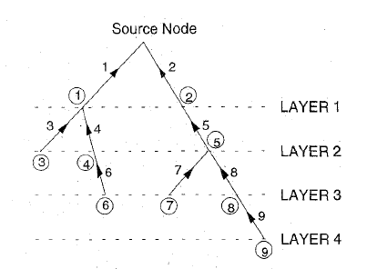
Modified Newton-Raphson method
Hence, the matrices H, N, J and L can be formed as:
$$H=L=A_{n−1}D_{B}A_{n−1}^{T}$$
$$J=−N=A_{n−1}D_{G}A_{n−1}^{T}$$
where $D_{B}$ and $D_{B}$ are diagonal matrices with diagonal entries to be $V_{i}V_{j}B_{ij}\cos{θ_{ij}}$ and $V_{i}V_{j}G_{ij}\cos{θ_{ij}}$, respectively. Therefore, the conventional Newton Raphson can be rewritten as:
$$\left[\begin{matrix}A_{n−1} & 0 \\ 0 & A_{n−1}\end{matrix}\right]\left[\begin{matrix}D_{B} & −D_{G} \\ D_{G} & D_{B}\end{matrix}\right]\left[\begin{matrix}A_{n−1}^{T} & 0 \\ 0 & A_{n−1}^{T}\end{matrix}\right]\left[\begin{matrix}∆θ \\ ∆V/V\end{matrix}\right]=\left[\begin{matrix}∆P \\ ∆Q\end{matrix}\right]$$
$A_{n−1}$ is an upper triangular matrix with all diagonal entries to be 1 and all non-zero off-diagonal entries to be -1.
[11] F. Zhang and C. S. Cheng, “A Modified Newton Method for Radial Distribution System Power Flow Analysis," in IEEE Transactions on Power System, vol. 12, no. 1, pp. 882-887, Feb 1997.

Slide 56
Modified Newton-Raphson method
By now it has shown that the Jacobian matrix can be formed as the product of three square matrices. It can be solved by back/forward sweeps as well. It defines:
$$\dot{E}=∆θ+j{∆V}/V$$
$$\dot{S}=∆P+j∆Q$$
$$\dot{W}=D_{B}+jD_{G}$$
Therefore, the formulations in Newton-Raphson method can be modified:
$$A_{n−1}\dot{S_{L}}=\dot{S}$$
$A_{n−1}\dot{W}A_{n−1}^{T}\dot{E}$=$\dot{S_{L}}$
$\dot{W}A_{n−1}^{T}\dot{E}$=$\dot{S_{L}}$
When solving $\dot{E}$, the diagonal matrix $\dot{W}$ can be inverted for each line. The diagonal in ${\dot{W}}^{−1}$ is denoted as the equivalent line impedance:
$Z_{eq}$=$R_{eq}+$j$X_{eq}$
[11] F. Zhang and C. S. Cheng, “A Modified Newton Method for Radial Distribution System Power Flow Analysis," in IEEE Transactions on Power System, vol. 12, no. 1, pp. 882-887, Feb 1997.

Slide 57
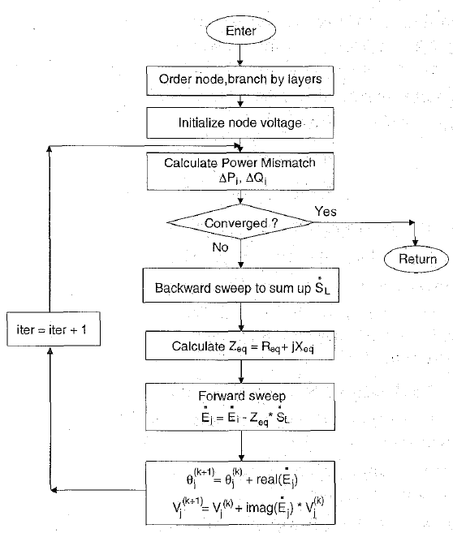
Modified Newton-Raphson method
$$A_{n−1}\dot{S_{L}}=\dot{S}$$
Backward sweep
$WA_{n−1}^{T}\dot{E}$=$\dot{S_{L}}$
Forward sweep
Fig.18 Flowchart of the modified Newton-Raphson method [11]
[11] F. Zhang and C. S. Cheng, “A Modified Newton Method for Radial Distribution System Power Flow Analysis," in IEEE Transactions on Power System, vol. 12, no. 1, pp. 882-887, Feb 1997.

Slide 58
References
[1] C. S. Cheng and D. Shirmohammadi, "A three-phase power flow method for real-time distribution system analysis," in IEEE Transactions on Power Systems, vol. 10, no. 2, pp. 671-679, May 1995.
[2] S. C. Tripathy and G. S. S. S. K. Purge Prasad, "Load flow solution for ill-conditioned power systems by quadratically convergent Newton-like method," in IEE Proceedings C - Generation, Transmission and Distribution, vol. 127, no. 5, pp. 273-280, September 1980.
[3] U. Eminoglu & M. H. Hocaoglu, “Distribution systems forward/ backward sweep-based power flow algorithms: a review and Comparison Study’, in Electric Power Components and Systems, 37:1, 91-110, 2008
[4] Kersting, William H. Distribution system modeling and analysis 4th edition. CRC press, 2017.
[5] Jen-Hao Teng, "A direct approach for distribution system load flow solutions," in IEEE Transactions on Power Delivery, vol. 18, no. 3, pp. 882-887, July 2003.
[6] Q. Zhang, K. Dehghanpour and Z. Wang, "Distributed CVR in unbalanced distribution systems with PV penetration," in IEEE Transactions on Smart Grid, vol. 10, no. 5, pp. 5308-5319, Sept. 2019.
[7] C. Zhang, Y. Xu, Z. Dong and J. Ravishankar, "Three-stage robust inverter-based voltage/var control for distribution networks with high-level PV," in IEEE Transactions on Smart Grid, vol. 10, no. 1, pp. 782-793, Jan. 2019.
[8] Gan, Lingwen, and Steven H. Low. "Systems and methods for convex relaxations and linear approximations for optimal power flow in multiphase radial networks." U.S. Patent Application No. 14/724,757.
[9] Anmar Arif, “Distribution system outage management after extreme weather events”, PhD Dissertation, Iowa State University, 2019.
[10] “Reference guide: The OpenDSS”, [online]: https://www.epri.com/#/pages/sa/opendss?lang=en
[11] F. Zhang and C. S. Cheng, “A modified newton method for radial distribution system power flow analysis," in IEEE Transactions on Power System, vol. 12, no. 1, pp. 882-887, Feb 1997.

Slide 59
Thank you!

